Slide 1
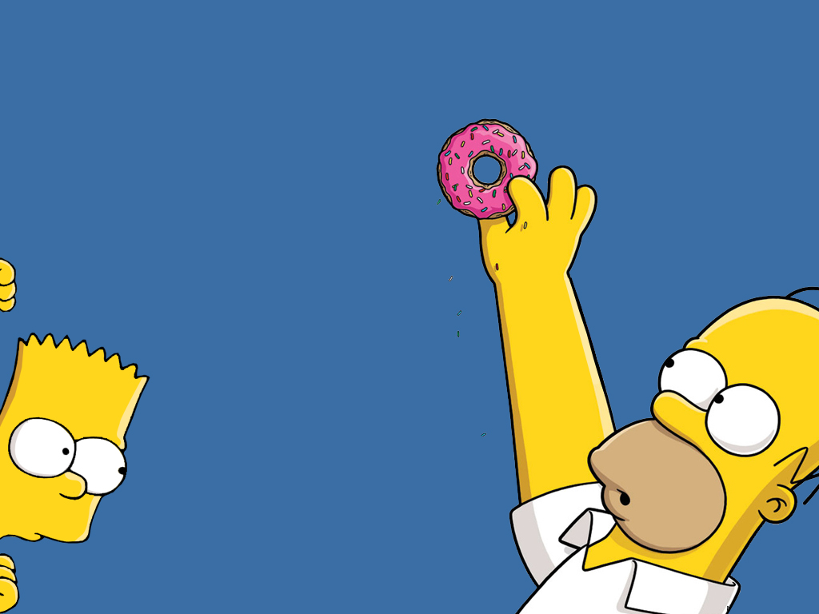
UNIT 1

Slide 2
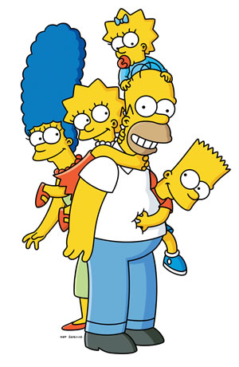
Simple
Present
This-That
These-Those
There is
There are
House
&
food

Slide 3
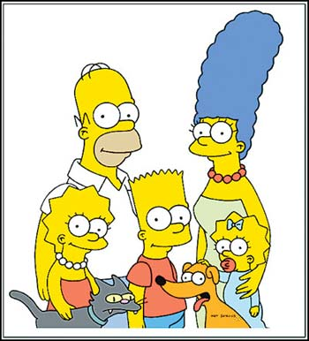
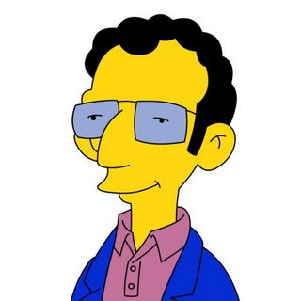
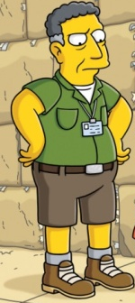
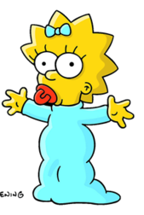
Simple Present
Flash Cards
I | I like
You | You like
He | He likes
She | She likes

Slide 4
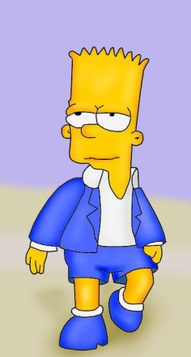
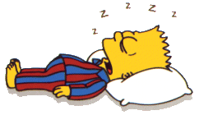
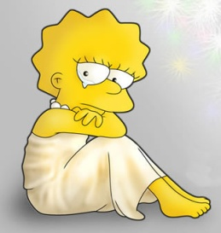
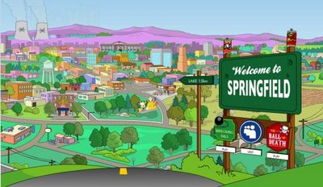
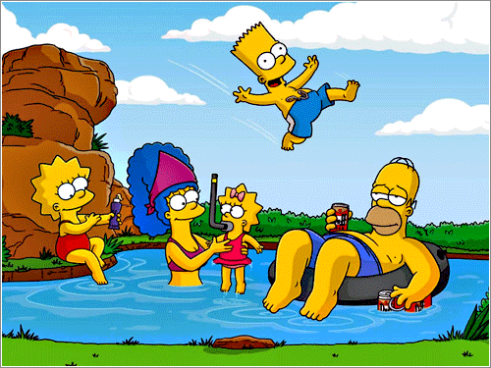
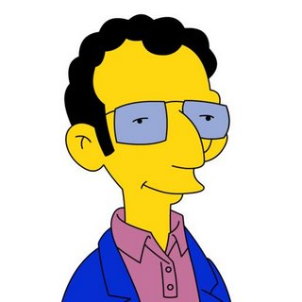
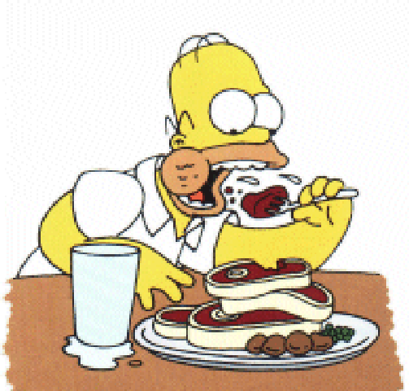

Simple Present positive form
Know
To sleep
I sleep
He sleeps
She sleeps
It sleeps
You sleep
We sleep
They sleep
I go
He goes
She goes
It goes
You go
We go
They go
To go
I cry
He cries
She cries
It cries
You cry
We cry
They cry
To cry
We use the Simple Present to talk about:
facts
Habits and routines
We live in Springfield.
They go to the lake every Summer
Feelings and emotions
Things that are true in general
You like meat.
Sunday comes after Saturday.

Slide 5
Simple Present positive form
Do

Slide 6
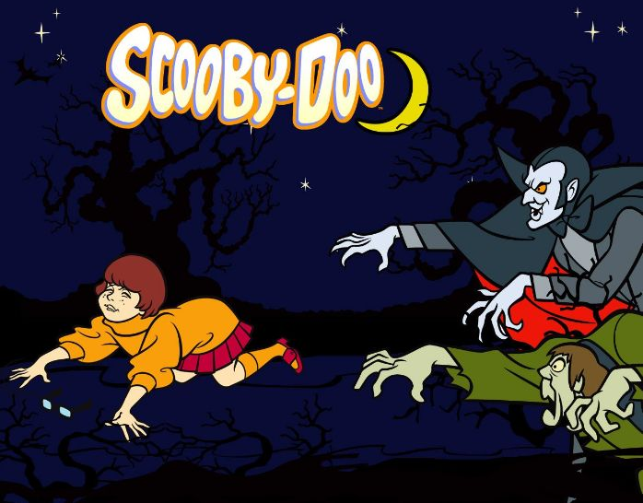

Slide 9
Verb to be (Am, Is, Are) Positive, Negative, Question
Be

